Slide 1





Data science in the medical industry

Slide 2
OVERVIEW
An insight into genetic information
Gene regulation and modelling
Exponential decay demonstrated
Analysing heart disease data
Quiz!

Slide 3


Major uses of data science
The drug BPM 31510 was discovered which detects and triggers the natural death of cells damaged by the disease. Helps against cancer.
Data science has helped make human cells resistant to ebola virus.

Slide 4
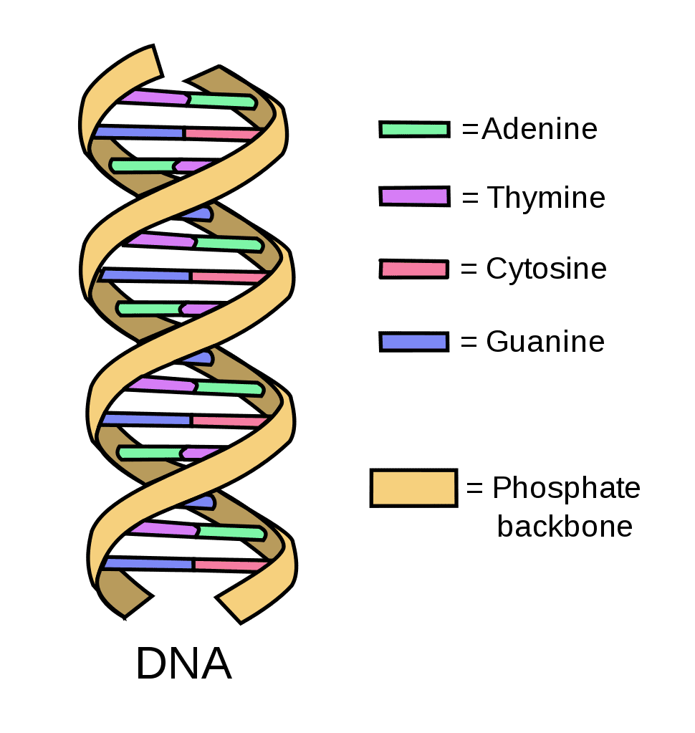
How is data science used in the medical field?
The human body contains 37.2 million cells.
There exists many types of macromolecules
DNA, RNA, and proteins are examples of macromolecule composing cells.
DNA &RNA are composed of Nucleotides (nucleic acid molecules):
There are two types of bases:
Pyrimidines
Cytosine (C) (DNA & RNA)
Thymine (T) (DNA)
Uracil (U) (RNA)
Purines
Adenine (A) (DNA & RNA)
Guanine (G) (DNA & RNA)

Slide 5
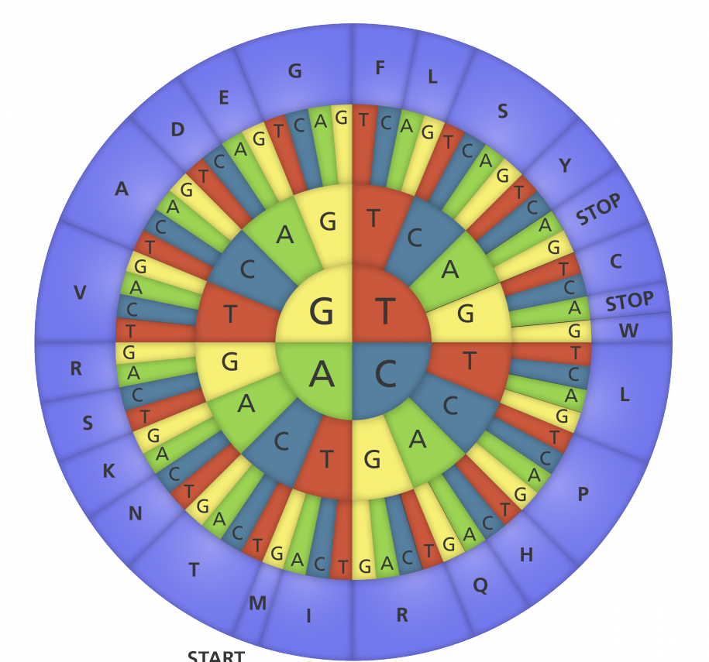
Transcription
Transcription is the process of copying a segment of DNA into RNA
Transcription evolves through 4 steps:
Initiation – the DNA macromolecule opens and an enzyme (RNA polymerase) binds with the promoter of the template strand.
Elongation – RNA polymerase processes each nucleotide on the DNA template strand to produce an mRNA (messenger RNA).
Termination – the transcription stops either when meeting a “Rho” protein factor or a loop at the end of the DNA strand.
Processing – the newly created mRNA macromolecule is processed by removing the introns and slicing the exons together so that only regions coding for proteins are maintained.
.

Slide 6
Obtaining an mRNA sequence
Given the sequence (template strand): 3’-CTGAATCGAT-5’ The mRNA sequence is obtained by substituting the nucleotides following the rule: C→ G, G → C, A→ U, T → A: We get: GACUUAGCUA

Slide 7

Feature Selection Methods
Feature selection methods are intended to reduce the number of input variables to those that are believed to be most useful to a model in order to predict the target variable.
Why?
Features may be redundant
Features may be irrelevant
Overfitting
Search problem – N features → 2^{N} subsets possible.

Slide 8
Methods used for feature selection
Filter methods where features are selected independently from the data analysis task
Wrapper methods where features are selected based on the resulting performance in the data analysis task (BMA)
Embedded methods where feature selection is performed during the data analysis task (no as preprocessing).

Slide 9
Filter Methods techniques : Filter methods pick up the key details of the features measured by univariate statistics: Chi-square Test, Fisher’s Score, Correlation Coefficient
Wrapper Methods Techniques: Wrappers require some method to search the space of all possible subsets of features. The feature selection process is based on a specific machine learning algorithm that we are trying to fit on a given dataset. Forward Feature Selection, Backward Feature Elimination

Slide 10
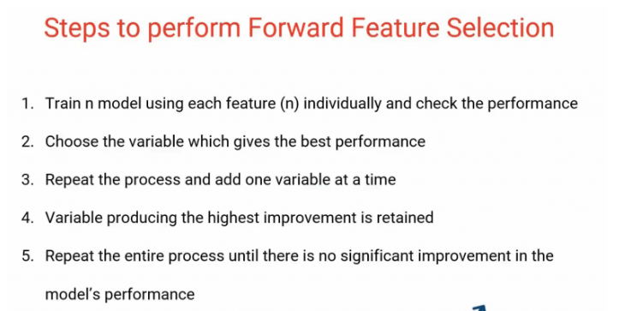
Forward feature selection:

Slide 11
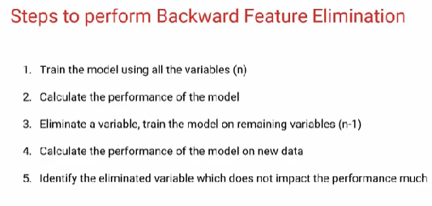
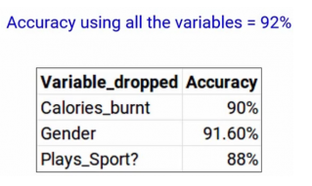
Backward Feature Elimination

Slide 12
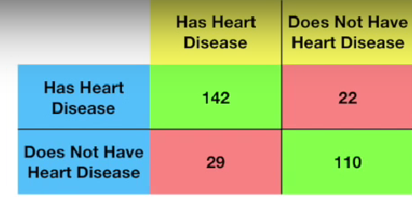
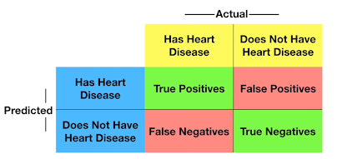

Confusion Matrix
What is a confusion matrix?

Slide 13

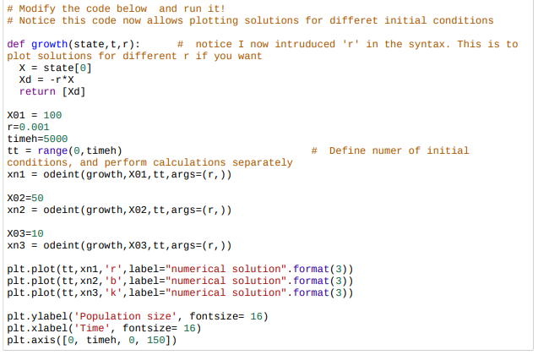
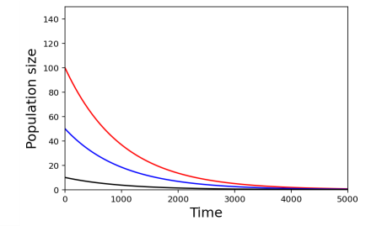
Exponential Decay
Solutions converge to zero, which is the steady-state This would represent a decay of mRNA. If x was an mRNA number.
Let’s say we are looking mRNA decay.

Slide 14
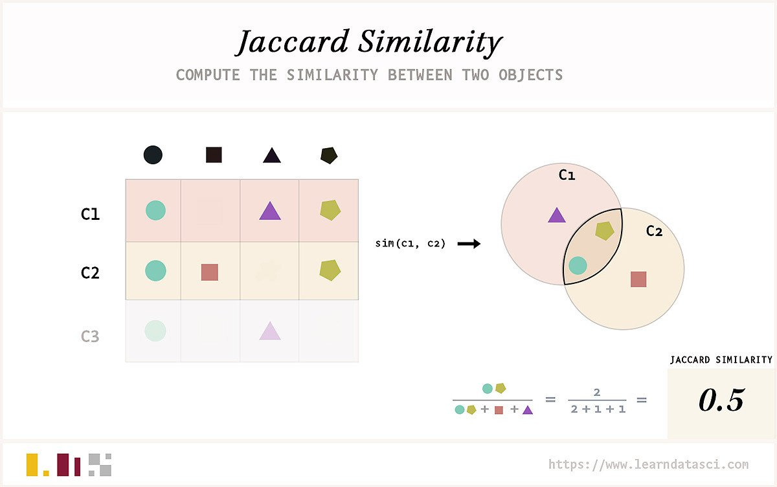
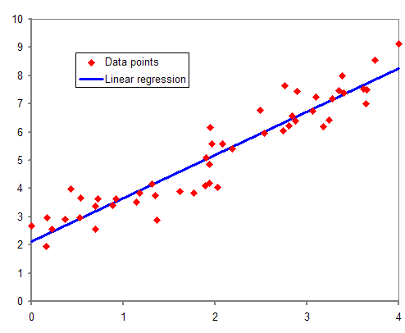
Accuracy/ Similarity scores

Slide 15
Heart Disease
Heart Disease.html
https://www.kaggle.com/datasets

Slide 16
Quiz time!
https://create.kahoot.it/details/699687c0-be57-4b15-8945-a4a2a4b9f53b

